Slide 1
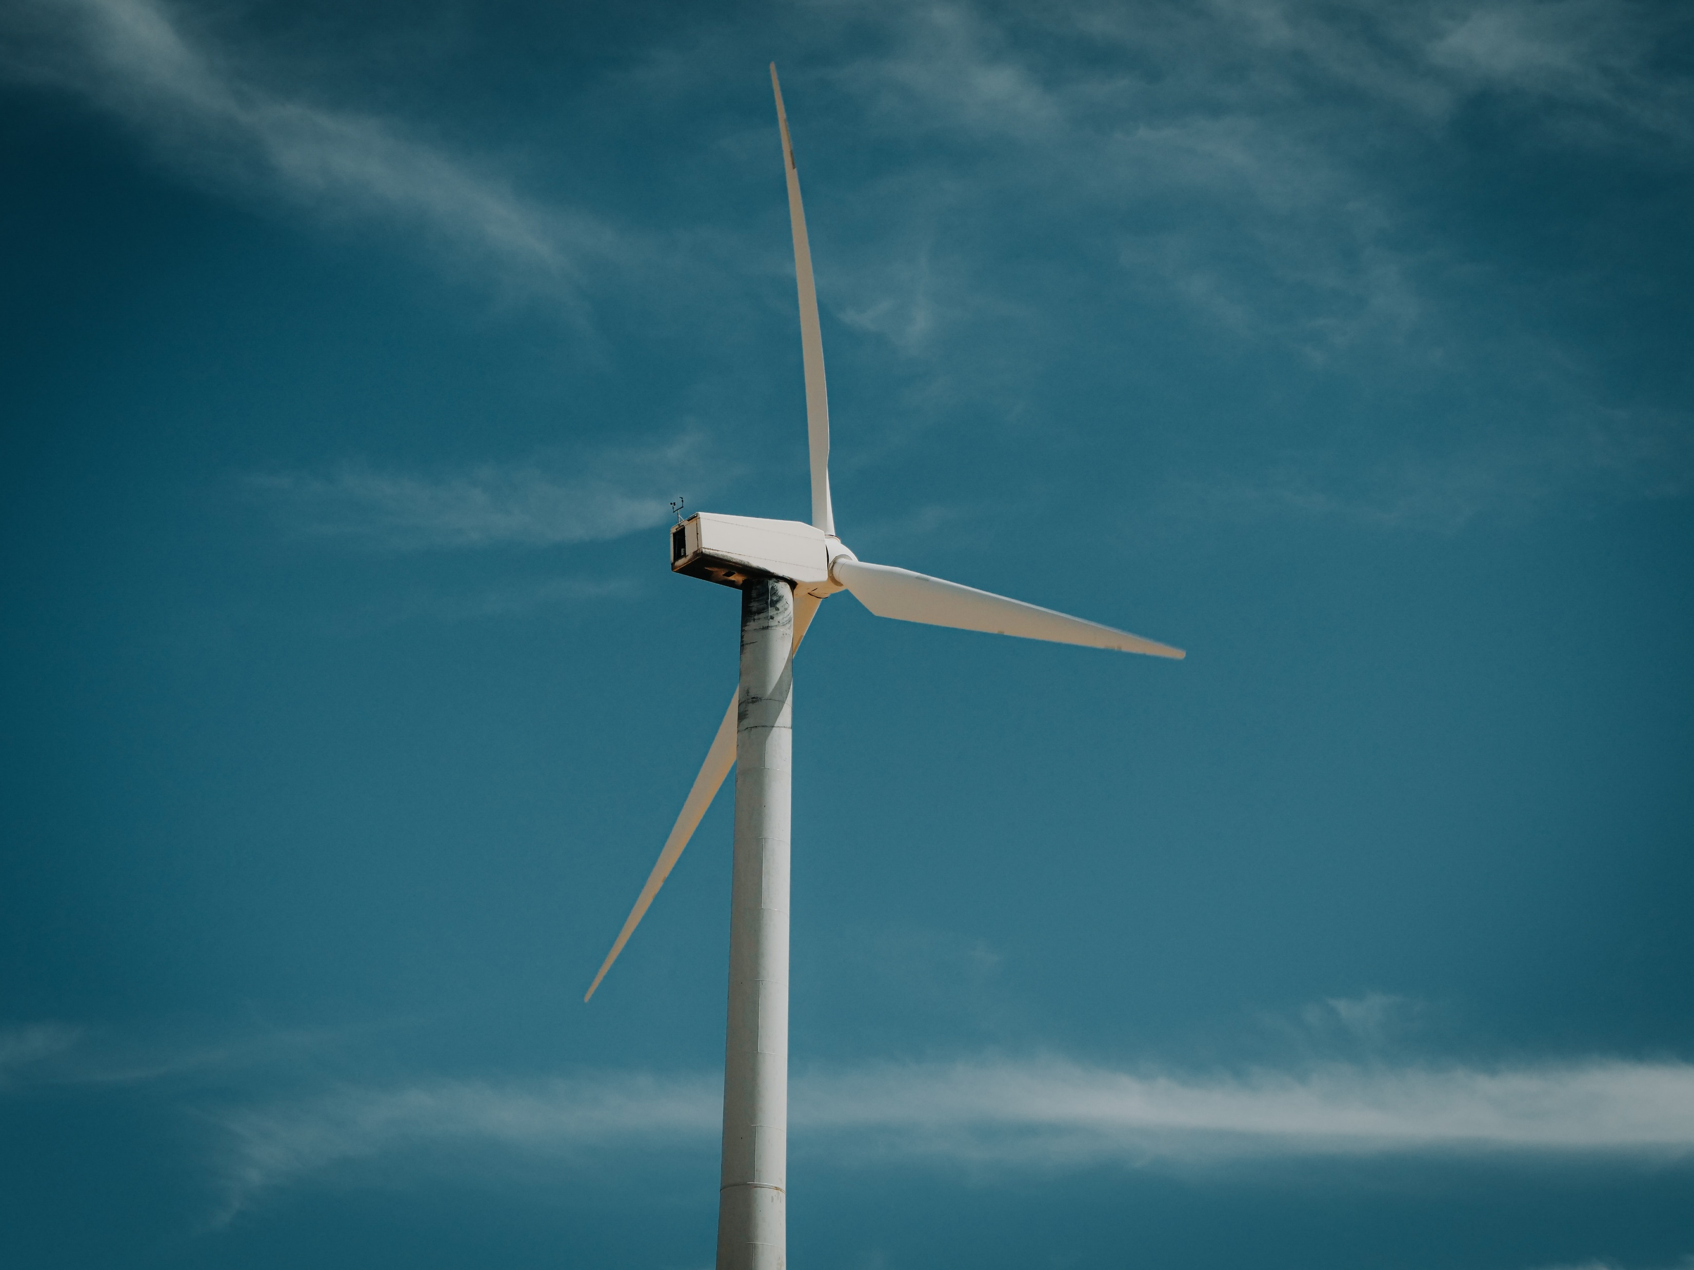





Inspection Services Collaboration Initiative

Slide 2

Offshore Wind Collaboration Initiative
Glacier Energy is now part of an Offshore Wind Collaboration initiative. The Initiative consists of Glacier Energy, Three60 Energy and Pryme Group (Caley and Flexlife).
The objective is to offer an integrated approach throughout any project’s lifecycle thus simplifying the procurement approach for developers of such complex projects.
The consortium offers industry leading expertise across the project lifecycle from the different companies within the initiative.

Slide 3


Simmons Fund Capability and Delivery
DEVEX
CAPEX
OPEX
Final Investment Decision
Offshore Construction Start
Production Start Up
Cable Installation
Dynamic power cable analysis
Mooring analysis
Cable integrity mgmt
CPS studies & design power cable & ancillaries (FEED)
Operational Services
Maintenance & Modifications
Decom
NDT (Advanced & Conventional)
Surveys, CSR, G&G, HSE
Array
Electrical
Transmission
7%
12%
24%
Foundation
3%
Array
Electrical
Transmission
Turbine
7%
4%
4%
2%
1%
Developer Project Management
Foundation
Conventional NDT with Rope Access
Blade Inspection
Coating Inspection / Coating Repair
STAT Inspection
Turbine
4%
Concept /
FEED
Environmental Studies
7%
Pipe Fixation PileProp Tool
24%
1%
1%
0%
PROJECT TIMELINE
PROJECT DEV – 3-5%
EPC - 30-40%
INSTALL & COM – 15-20%
O&M – 25-45 %
Share Of Total
Share Of Total
Share Of Total
Share Of Total

Slide 4
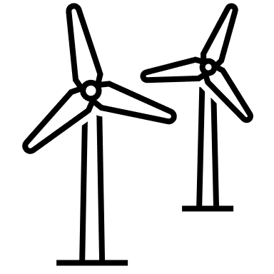
Devex
Project Development and Engineering
CURRENT
FUTURE
Pre-appraise & concept studies on and offshore substations
Owners Engineer, PM
Multi-Discipline engineering (mechanical, electrical, tech. safety. I&C & structural)
Client Representative Services (CSR), site investigation surveys, HSE supervision, vessel auditing
Share of Lifecycle Cost
Concept / FEED
0%
Environmental Studies
1%
Developer Project Management 1%

Slide 5
Capex
Engineering, Procurement and Construction (EPC)
CURRENT
FUTURE
CPS design overview and package management.
3rd party analysis and Design overview of power cables and ancillaries.
Package FEED & detail design engineering,(substations, secondary steel / structural)
Onshore structures & civil (onshore substation)
Design Consultancy/EPC/Product Delivery of jacket and pile lifting tools; Pile Grippers; Pile Templates
Owners Engineer (technical assurance) / PMO services
Owner’s engineer for cable manufacturing.
Turbine
24%
Foundation
7%
Array Electrical
4%
Transmission
4%

Slide 6
Capex
Installation and Commissioning
CURRENT
FUTURE
Power cable installation analysis
Fit out on & offshore substations & nacelles
Mooring analysis
Commissioning substations and nacelles
Owner’s engineer for cable installation
HV works & grid connection
EPC/Product Delivery of specialist tooling for foundation installation support (PileFixation/PileProp)
Rope access capability
EPC/Product delivery cable handling (Carousels, Tensioners, Spoolers, Cable Lay).
Owners Engineer (technical assurance) / PMO services
NDT – advanced and conventional
Turbine
2%
Foundation
4%
Array Electrical
7%
Transmission
3%

Slide 7
Opex
Engineering, Procurement and Construction (EPC)
CURRENT
FUTURE
Onshore electrical O&M
Offshore facility management / ‘duty holder’
Senior Authorised Person (SAP)
Offshore O&M; substation, tower upgrades /mods
Conventional & Advanced NDT, rope access, blade inspection and repair
Rope access capability, IRM / balance of plant
QA/QC, Welding Inspection, STAT inspections
Decom planning, engineering support & management
Cable integrity management
Drone inspections, Robotic Inspection
Operational Services
12%
Maintenance and Modifications
24%
Decom
7%

Slide 8
Thank You

